Slide 1
Employee Data Analysis using Excel
STUDENT NAME:A.Selvarani
REGISTER NO:312216518 I’d: autunm1647cb1221647018
DEPARTMENT:BCOM(Bank Management)
COLLEGE:R.B Gothi Jain college for women,Redhills

Slide 3
PROJECT TITLE
Employee Performance Analysis using Excel

Slide 4


AGENDA
Problem Statement
Project Overview
End Users
Our Solution and Proposition
Dataset Description
Modelling Approach
Results and Discussion
Conclusion
3/21/2024 Annual Review

Slide 5

PROBLEM STATEMENT
Employee performance analysis using excel involves evaluvating
And measuring an employee’s work effectiveness and efficency
Based on key performance indicators(KPIs).This data is then analyzed using excel function and tools, such as pivot tables,
Chart,and conditional formatting,to identify patterns, strengths
And areas for improvement.The analysis help in making informed decision regarding training needs, promotion,and
Overall workforce optimization

Slide 6

PROJECT OVERVIEW
The project”Employee performance Analysis using excel”aim to systematically
Evaluate employee productivity and effectiveness by leveraging Excel’s
Analytical tool.The project will involve collecting and organizing performance
Data such as task completion rates, accuracy,and attendence records.This
Data will be processed and analyzed using excel function like pivot tables,
Charts,and stastical formulas to generate insights into individual and teams
Performance.The outcome will help in identifying top performers, recognizing
Training needs,and make data-driven decision for performance improvement.
The final deliverable will include detailed report and visual dashboard for
Easy interpretation and strategic planning

Slide 7
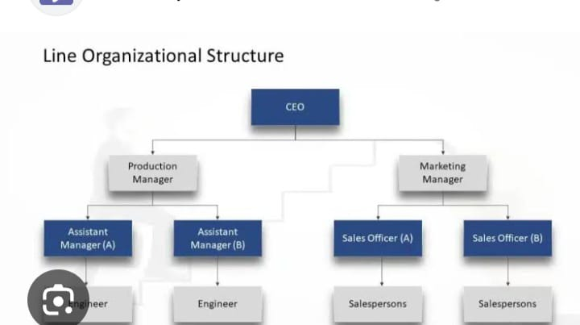

WHO ARE THE END USERS?
The end users are also known as end consumer
The production is the process of converting raw material into finished product to the consumer
Delevering the goods and services to the end users to last step of supply chain
Employee, employee manager
M.s office

Slide 8

OUR SOLUTION AND ITS VALUE PROPOSITION
Data-driven insights: Enables managers to make informed decision based on accurate,real time performance data
Improved efficiency:Automates the data collection and Analysis process,saving time and reducing manual errors
Enhanced employee development: identifies training needs and development opportunities, leading to a more skilled workforce
Better performance management:Help in recognizing top performers and addressing underperformance, ultimately improving overall productivity
Cost-effective solution: Leverage the widely accessible excel platform, avoiding the need for expensive software or tools.

Slide 9
Dataset Description
Employee database
Features
9 features
Employee I.d
Performance
Current rating employee
Employee type
Gender male and female

Slide 10

THE "WOW" IN OUR SOLUTION
Predictive Analytics: integrating predictive models to forecast future performance trends based on histrocial data, giving managers a proactive Approach to workforce planning.
Automated Alerts:the tool can be set up to send to automated Alerts for critical performance issue,ensuring that managers are immediately notified when attention is needed
3/21/2024 Annual Review
10

Slide 11
MODELLING
In the “Employee performance Analysis using excel” Project the modeling phase involve setting up the excel work book with various tools and technique to analyze and visualize the data effectively here’s how each components will be used;
1.Data filtering
Purpose: To sort and refine the data to focus on specific criteria,such as department,data range or individual performance
Implementation: Excel filtering feature will be applied to datasets, allowing users to easily narrow down the data to view only the relevant information .for example, filtering by department or by performance rating
2.Pivot table
Purpose:To summarize and analyze large dataset by grouping and aggregating data based on different performance metrics
Implementation: pivot tables will be used to dynamically calculate and display key performance indicators (KPIs) such as average task completion time,total hours worked,or percentage of target met.
11

Slide 12
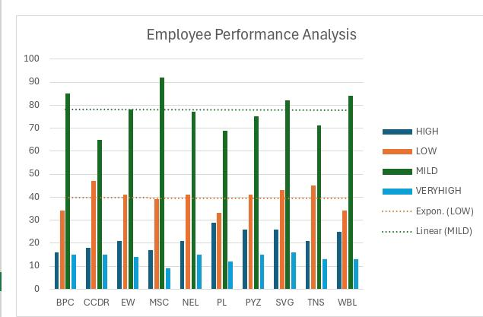
RESULTS
12

Slide 13
conclusion
The “Employee performance Analysis using excel”project provides a robust and user friendly solution for evaluating and managing employee performance. By leveraging Excel’s powerful tools-such as filtering, pivot tables,charts,and conditional formatting-the project transforms raw performance data into actionable insights. The resulting interactive dashboard and customizable report empower Manager to make data driven decision, optimize workforce productivity,and foster continuous improvement across the organization.This solution not only streamline performance management but also offer a cost-effective, scalable approach to enhancing overall organisational efficiency

Slide 14
Thank you

